Slide 1

Cloud-Based File Storage System
Omar Cusma fait - Cloud Computing Basic Course – 2023/2024

Slide 2

Project Overview
Objective: Deploy a self-hosted cloud storage platform with monitoring and performance testing capabilities
Requirements Addressed: ✓ User authentication & authorization ✓ Private storage spaces ✓ File operations (upload/download/delete) ✓ Scalability, security, and cost-efficiency
Key Components: - Nextcloud: File storage and user management - Docker Compose: Container orchestration - Prometheus + Grafana: Monitoring and visualization - Locust: Load testing and performance analysis

Slide 3
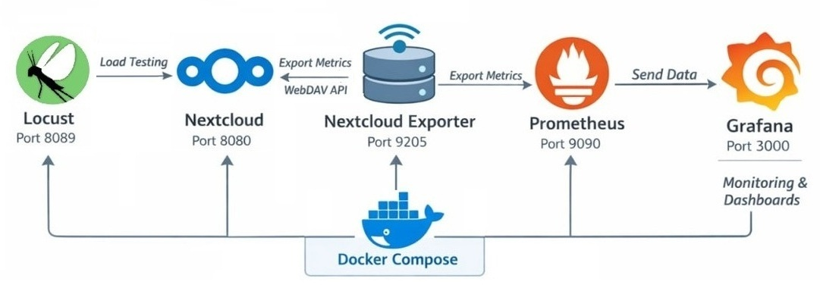
System Architecture

Slide 4
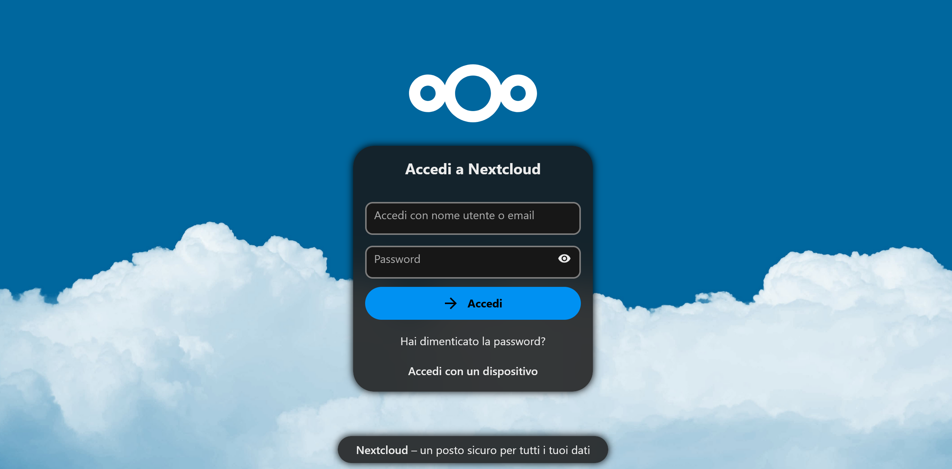
Nextcloud Features
Admin Capabilities: - ✓ User account creation and management - ✓ Private storage allocation per user (`/remote.php/dav/files/username/`) - ✓ Group management and permissions - ✓ System configuration and security settings
User Capabilities: - ✓ Upload/download/delete files - ✓ Sign-up, log out - ✓ File preview (images, PDFs, text) - ✓ Folder creation and organization - ✓ Web interface and desktop sync
To log in, visit http://localhost:8080

Slide 5



Monitoring Stack
Nextcloud Exporter - Scrapes Nextcloud internal metrics - Exposes data at `http://localhost:9205/metrics` - Key metrics: active users, file count, response times
Prometheus - Time-series database - Scrape interval: 30 seconds - Configuration: `prometheus/prometheus.yml`
Grafana - Auto-provisioned Prometheus datasource - Custom dashboards for real-time monitoring - Access: `http://localhost:3000`

Slide 6
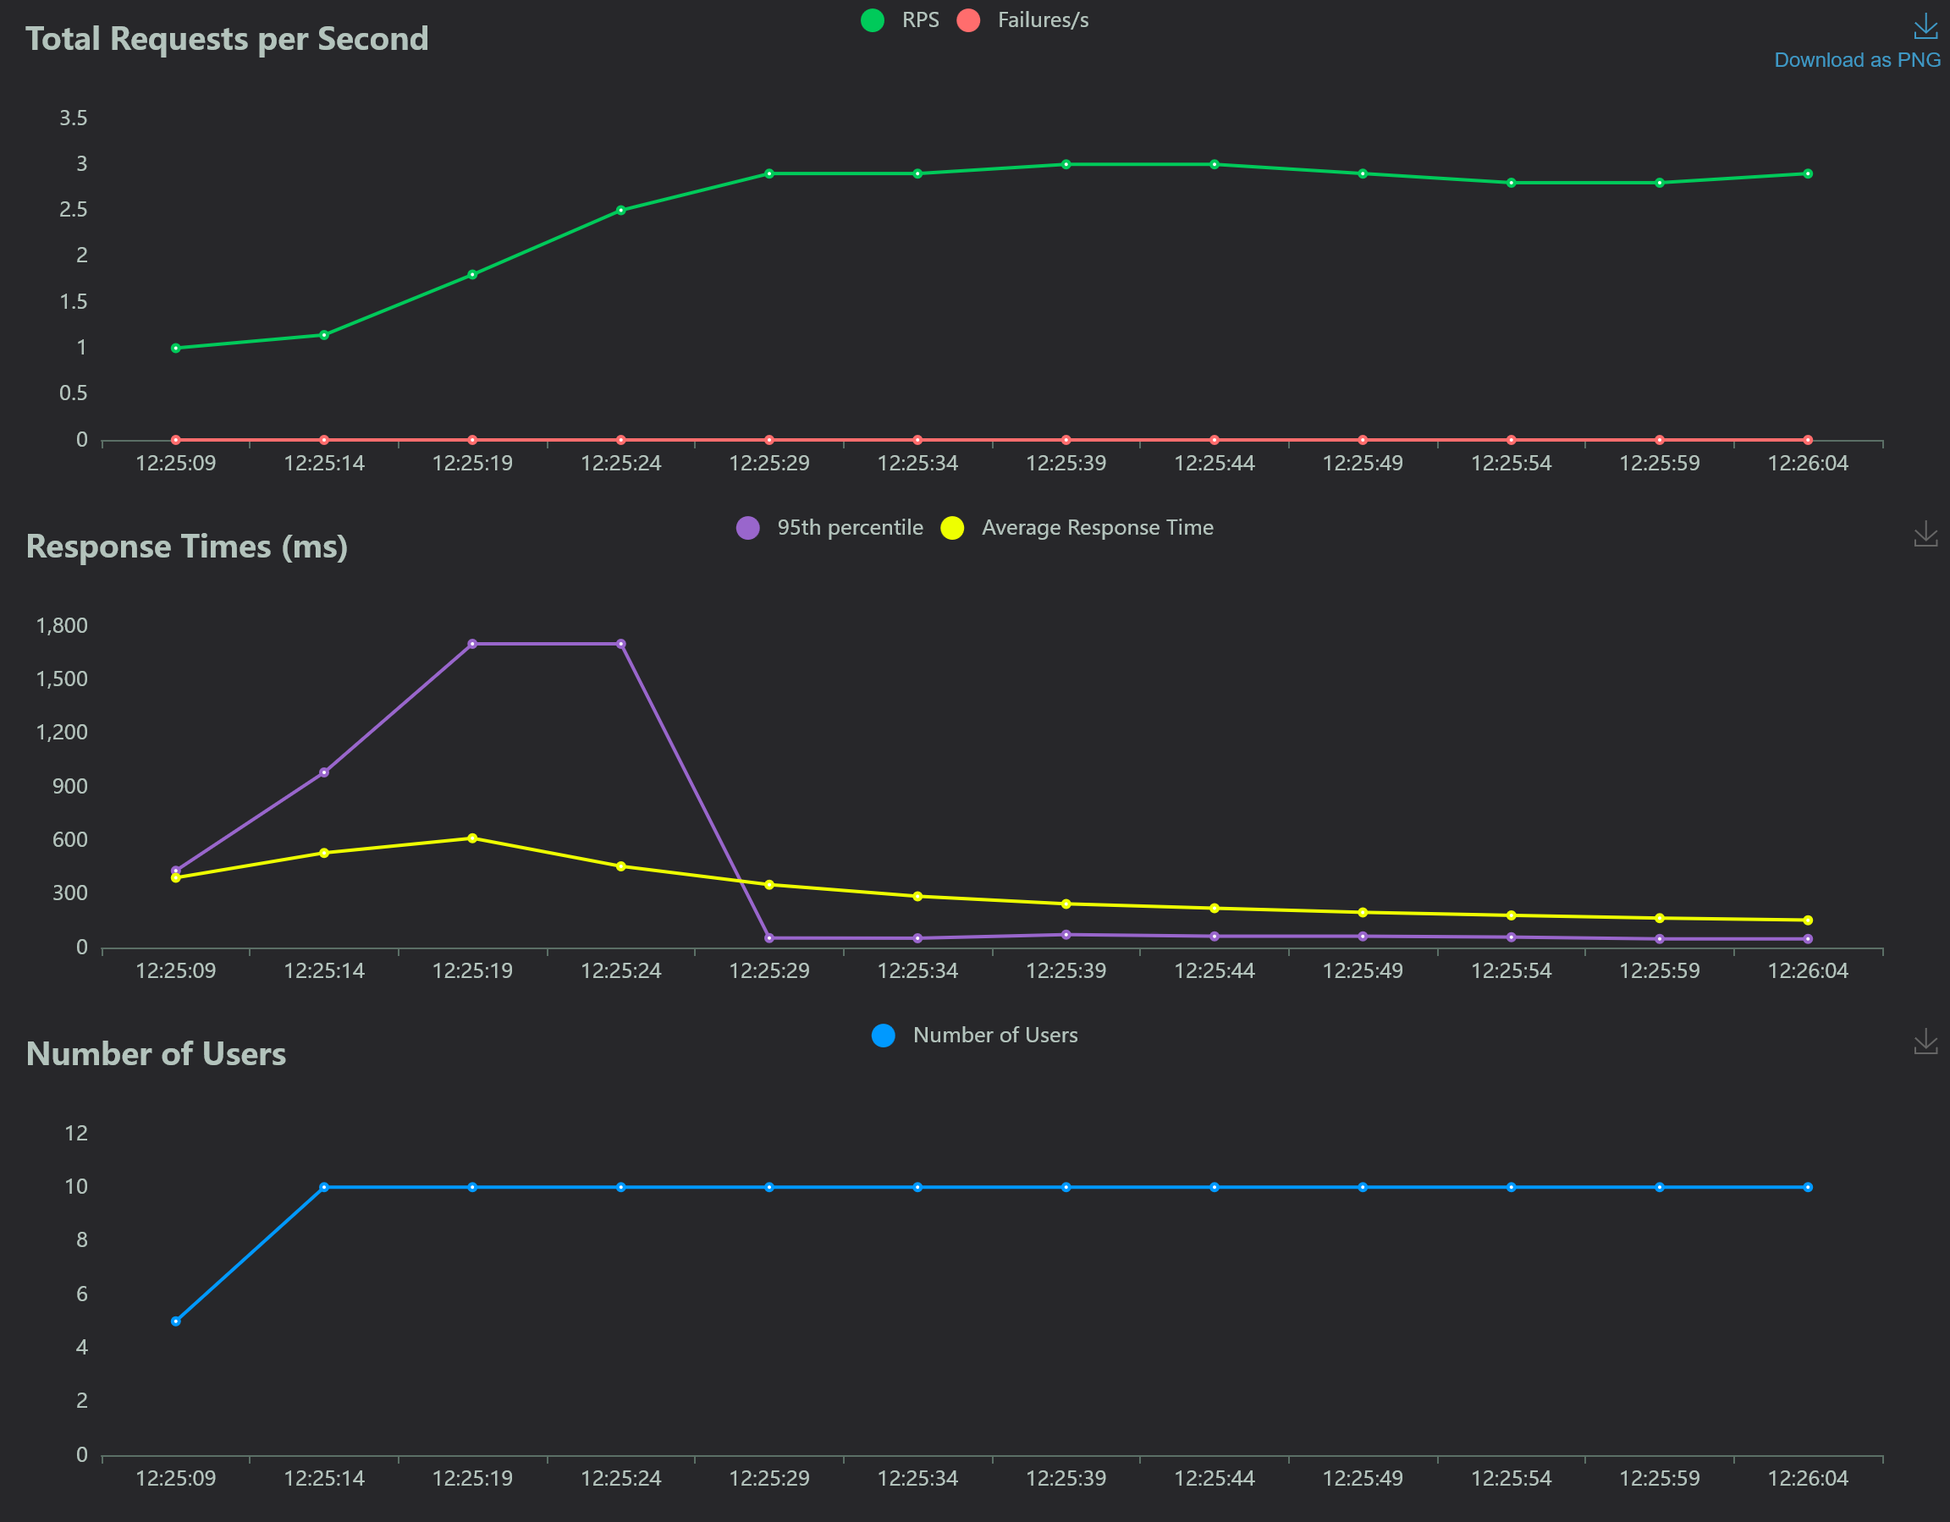
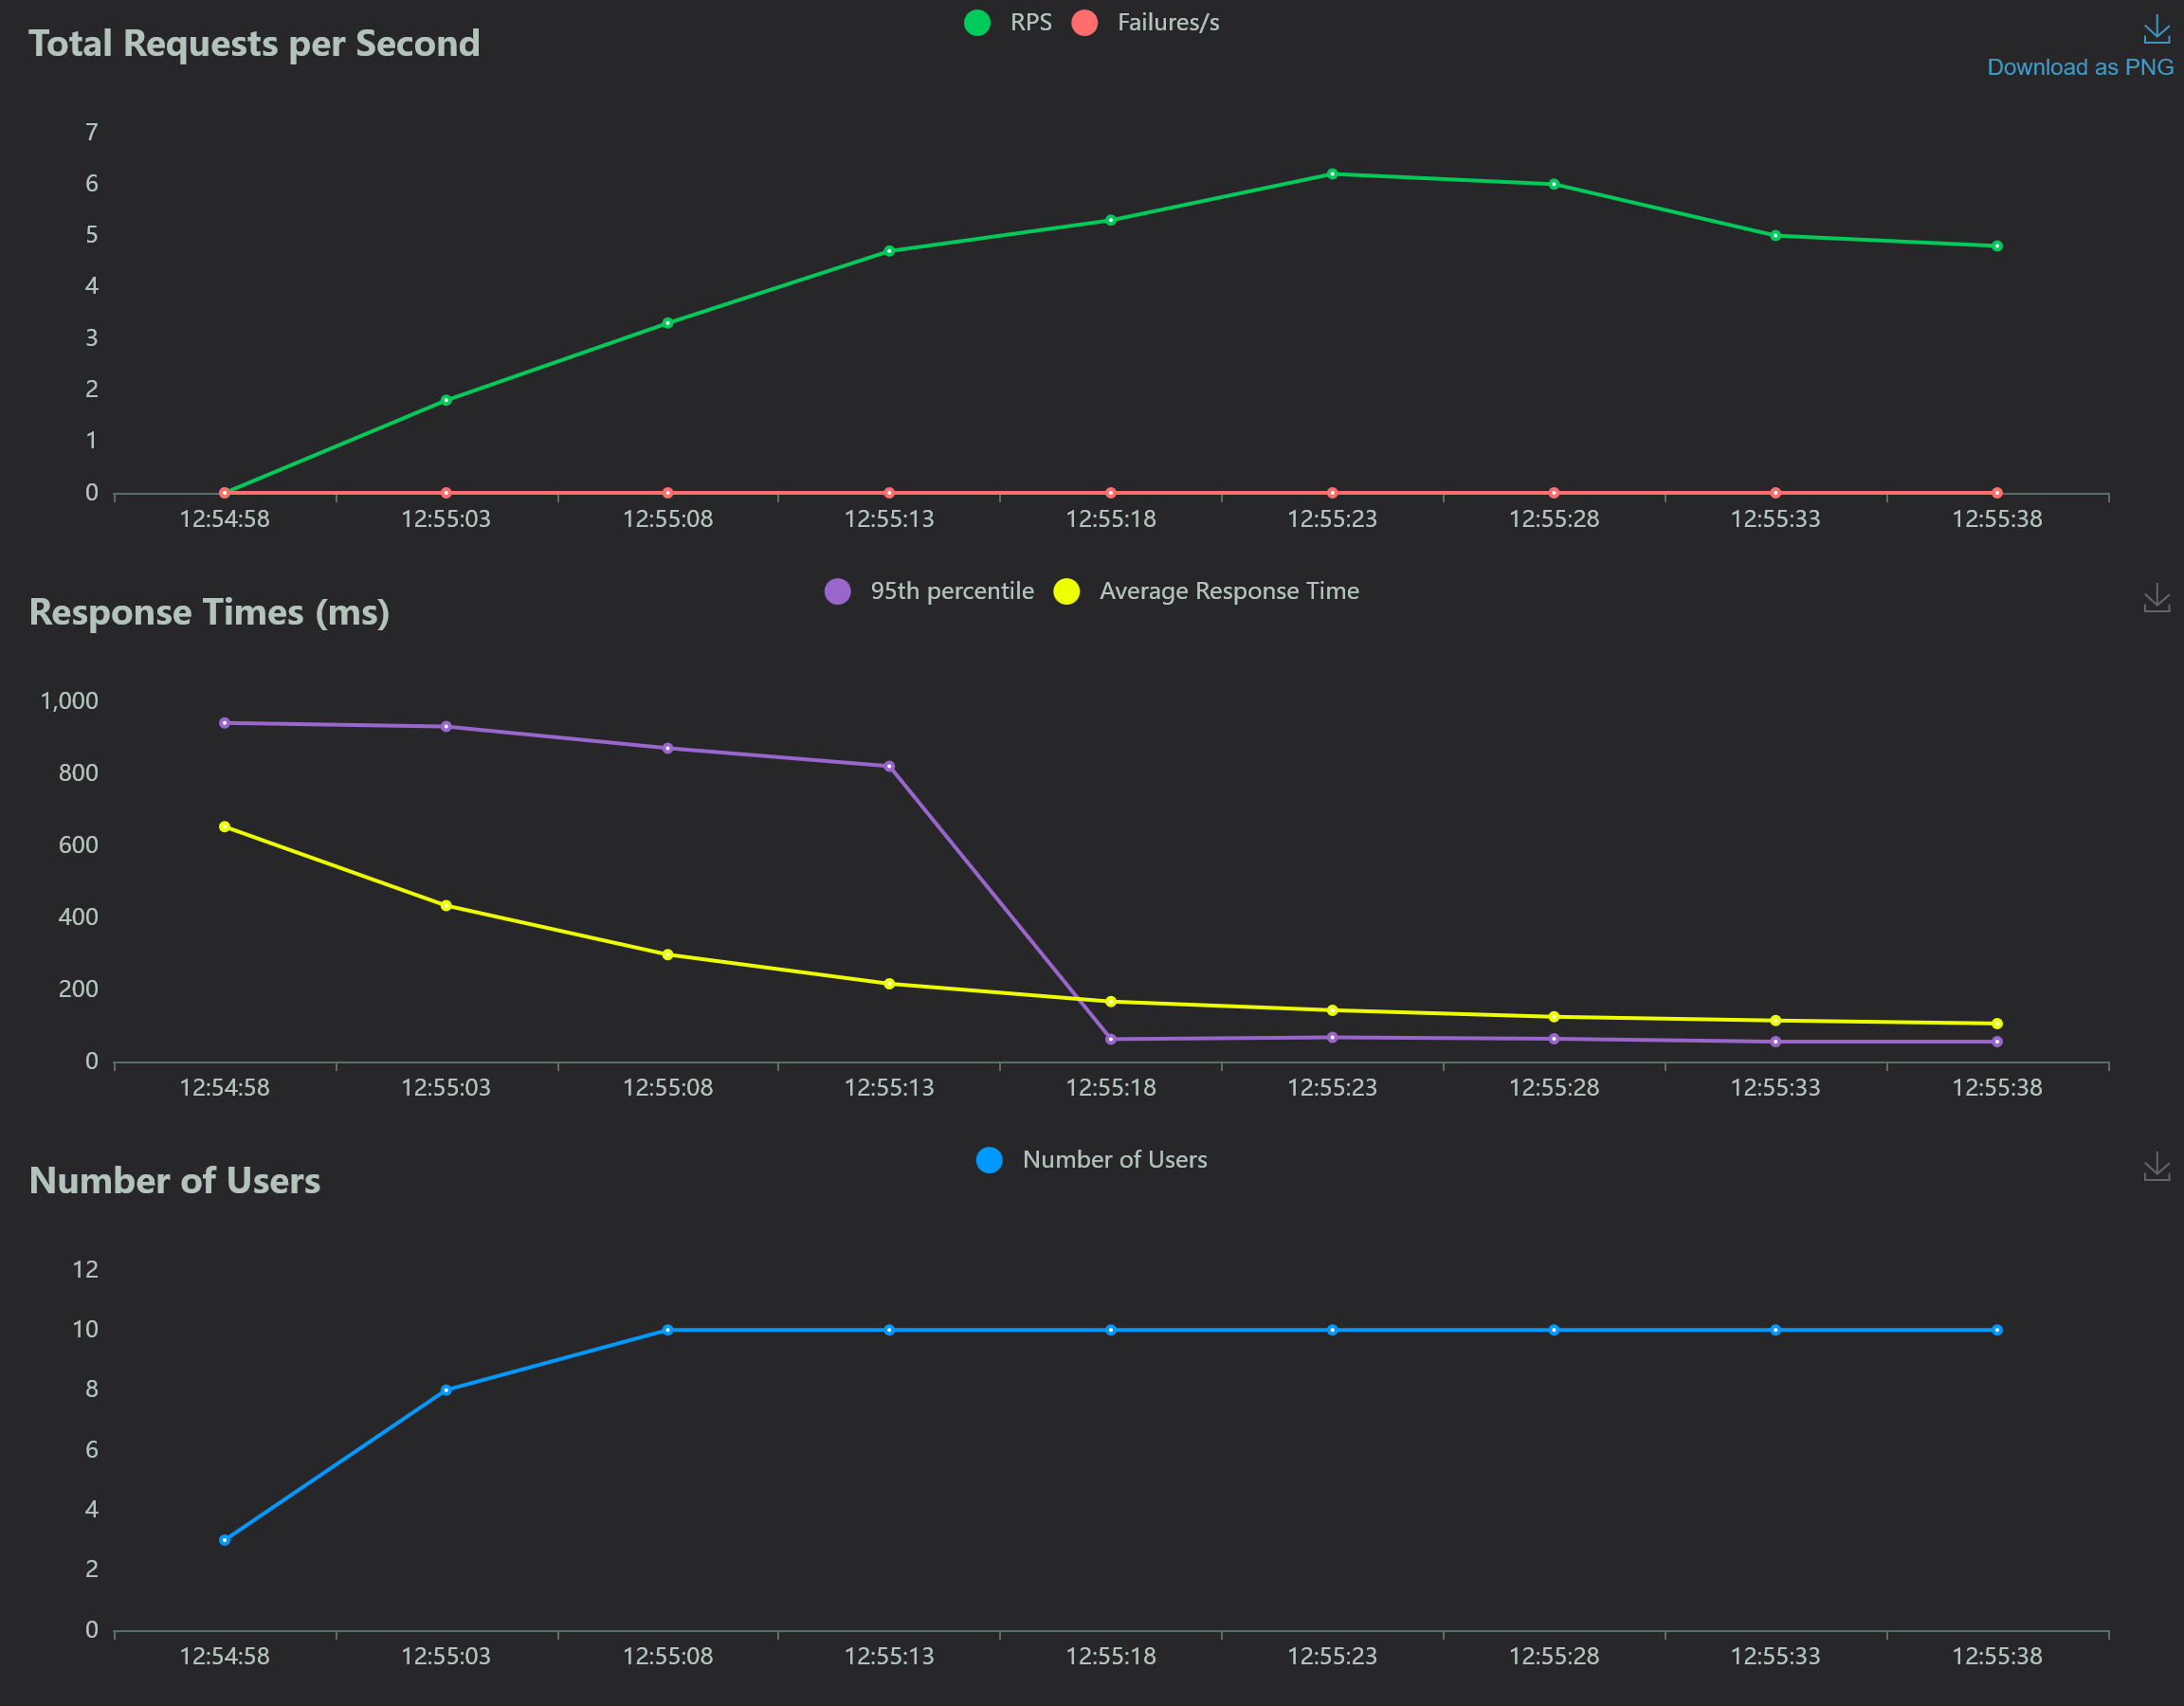
Load-testing results: 500kB - 5MB

Slide 7
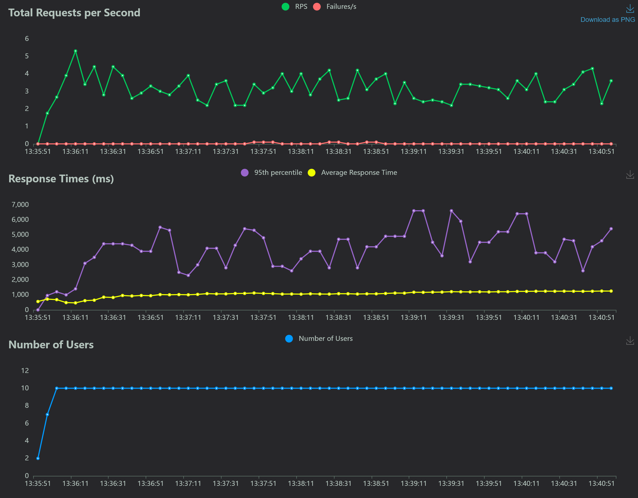
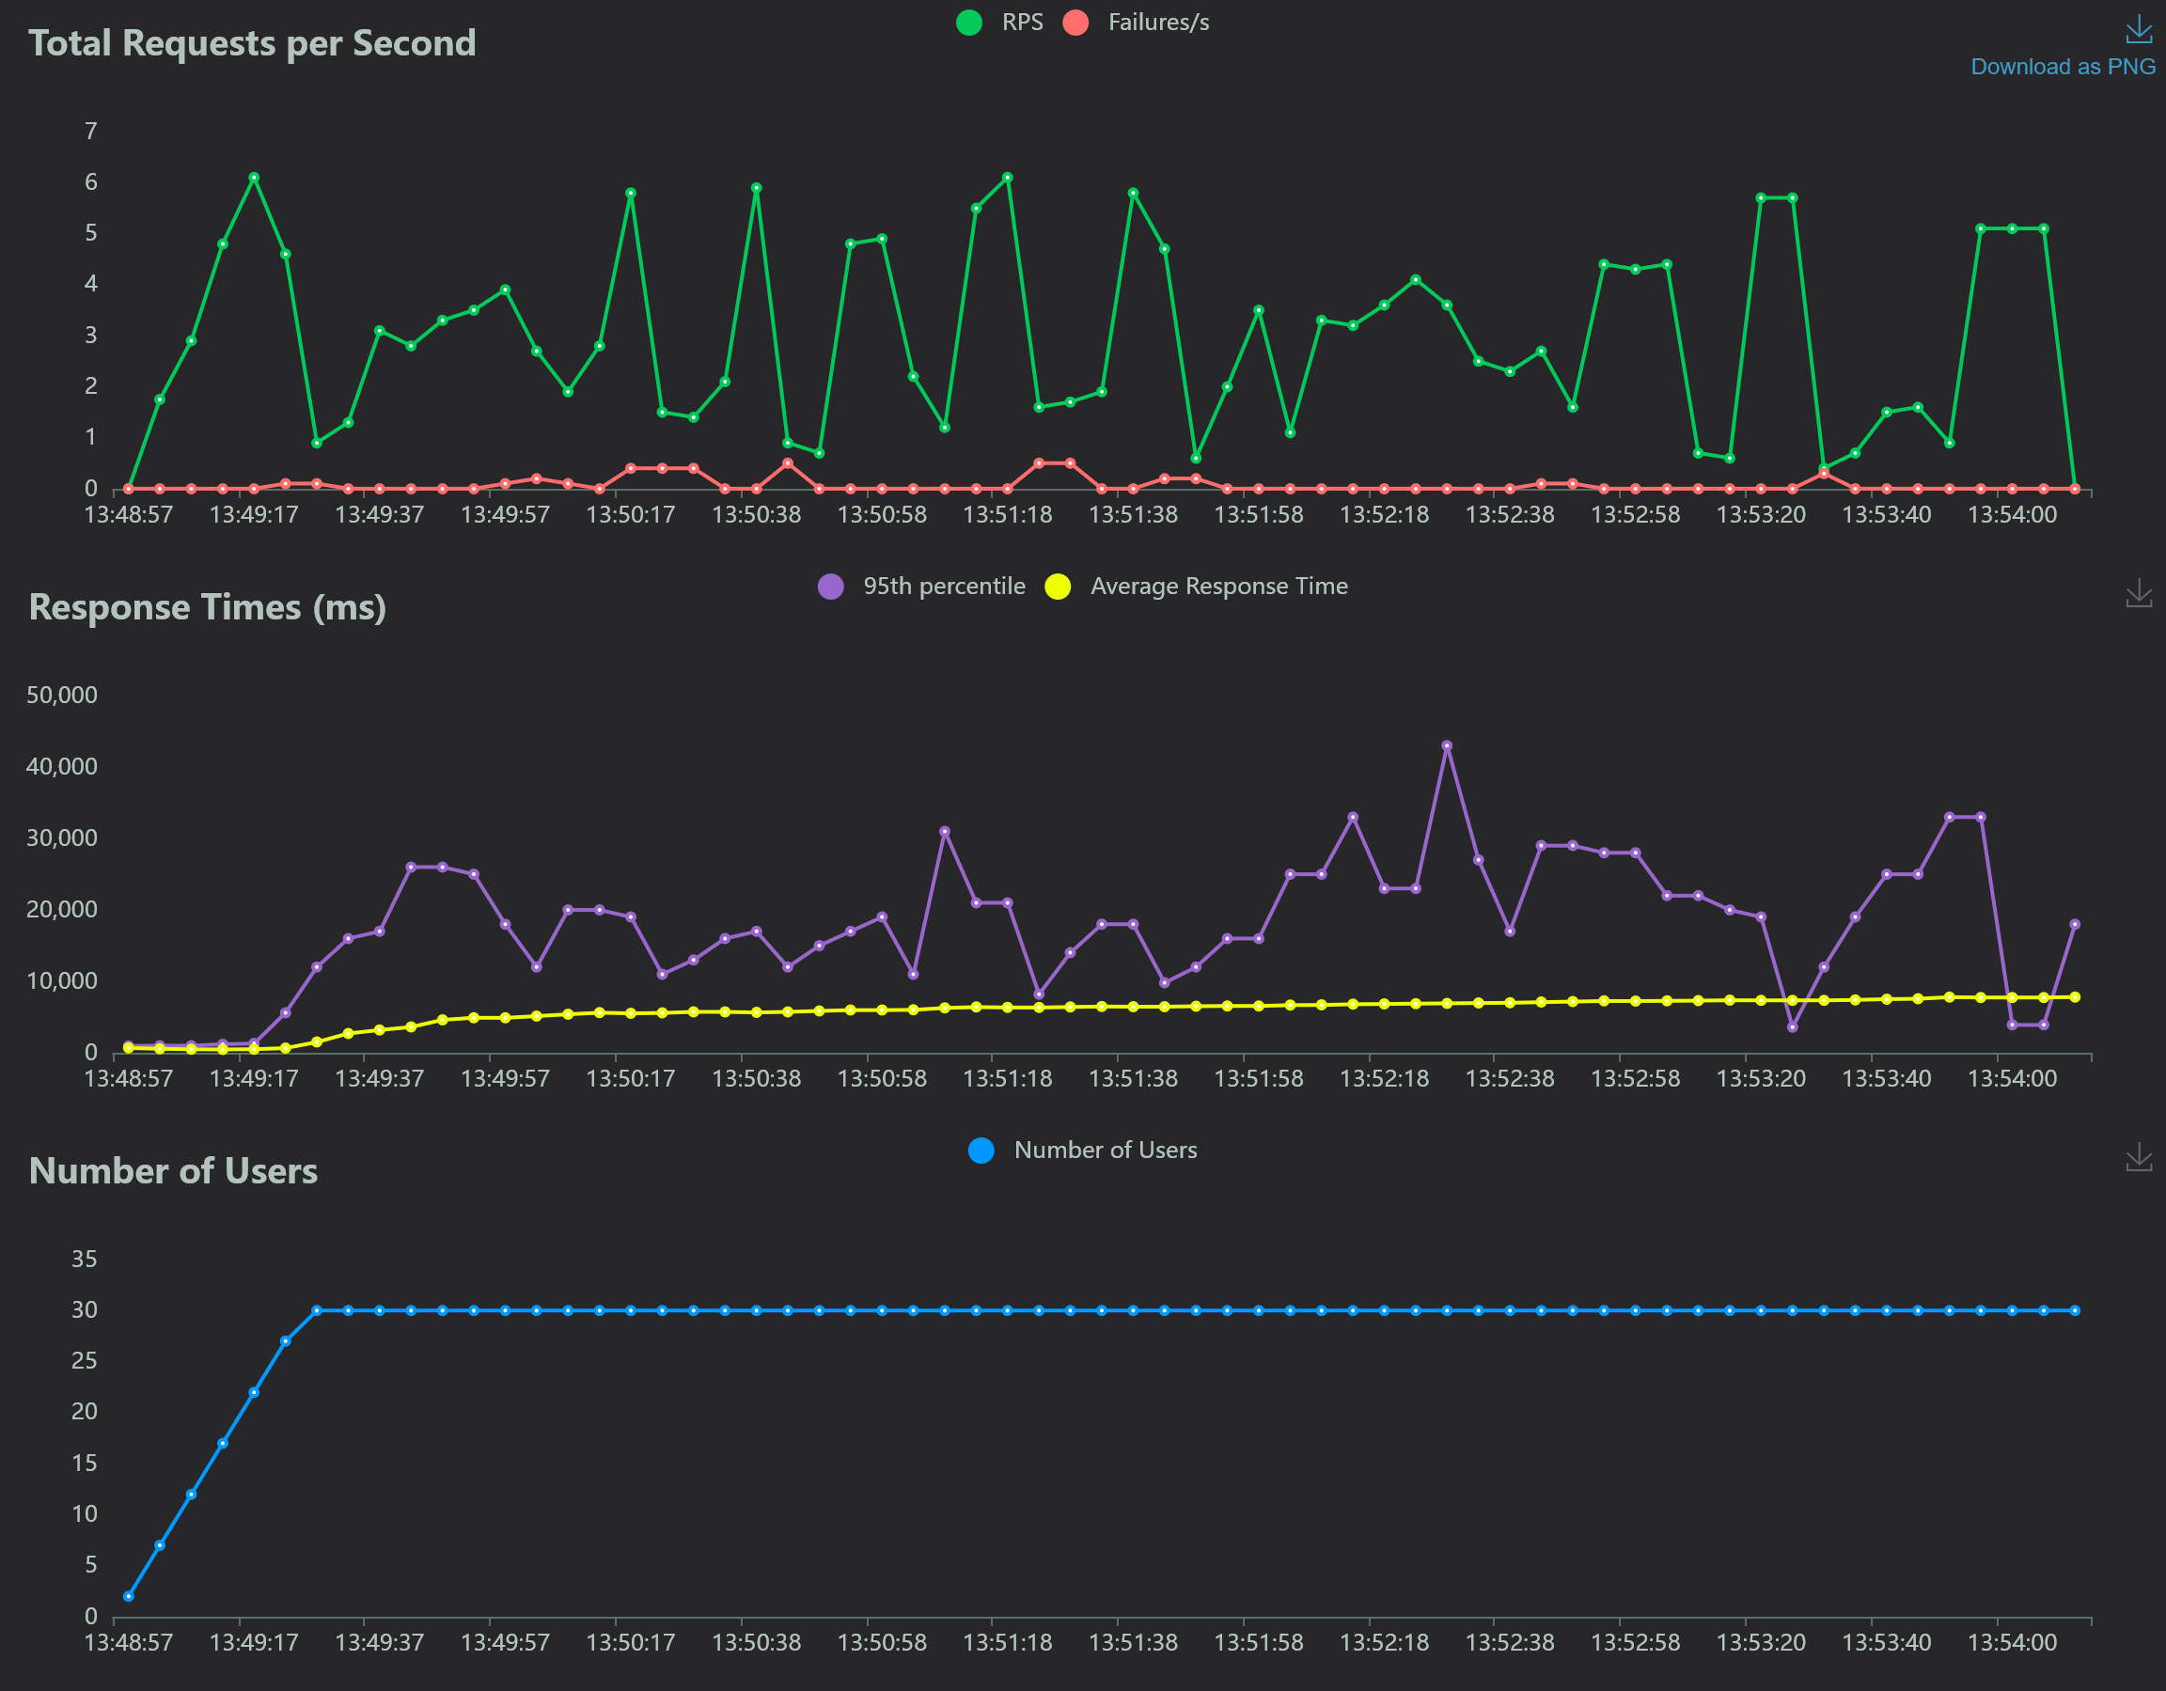
Load-testing results: 50MB

Slide 8
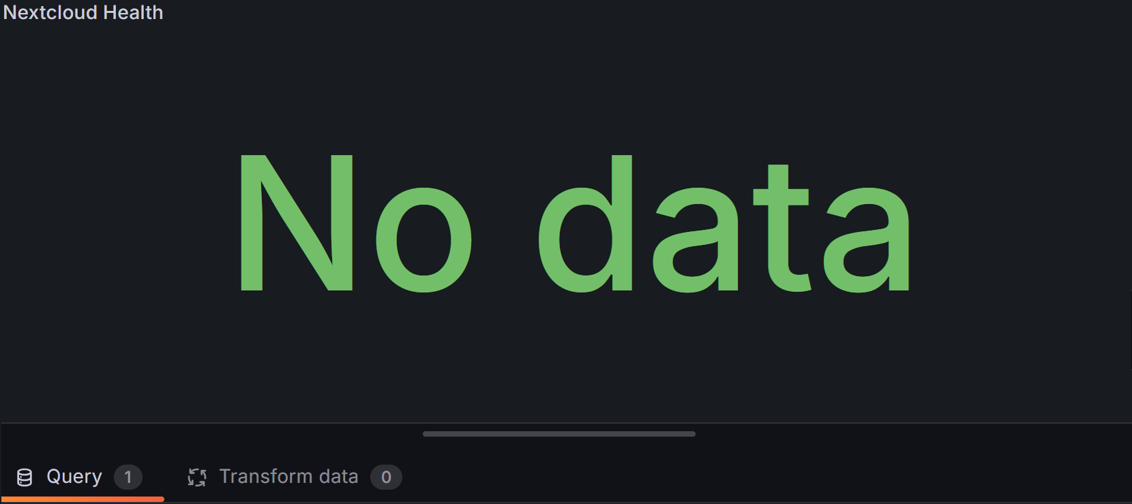
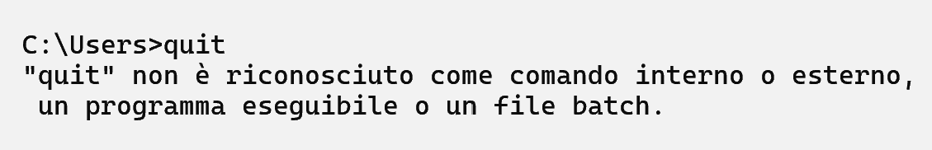
Challenges & Solutions
The Nextcloud Exporter was unable to pull metrics from Nextcloud.
Nextcloud was blocking the exporter because it was scraping too frequently.
This resulted in: nextcloud_up = 0
WSL files from the stress-test almost filled up the disk with thousands of 50MB temporary files
deleting them didn’t help!
The Windows diskpart tool saved the day
Many small issues… but I didn’t give up!

Slide 9

Achievements
✓ Fully containerized Nextcloud deployment
✓ Complete monitoring stack (Prometheus + Grafana)
✓ Automated load testing with Locust
✓ Comprehensive documentation and execution logs

Slide 10
Performance Insights
Medium files (5MB): median response ~44–49 ms at 10 concurrent users
System handles well moderate concurrent load
Load testing shows that performance is consistent for any small number of users

Slide 11
scaling and other Improvements
Security: Add TLS/SSL via reverse proxy (Traefik/Nginx)
Scalability: PostgreSQL + Redis backend; horizontal scaling
Cloud Deployment: AWS EC2 + S3 with auto-scaling
Larger Scale Tests: GB-sized files and 100+ concurrent users

Slide 12
Cost-Efficiency
All open-source components (zero licensing)
Lightweight containers optimize resource usage
Cloud deployment would use spot instances for cost optimization

Slide 13

Thank you

